Slide 1
Knowledge Base
Introduction, or what is knowledge?
Rules as a knowledge representation technique
The main players in the development team
Structure of a rule-based expert system
Characteristics of an expert system
Forward chaining and backward chaining
Conflict resolution
Summary

Slide 2
Data = facts.
Examples
Information is manipulated data.
Examples.
Knowledge is a theoretical or practical understanding of a subject or a domain.
Examples

Slide 3

Discrete Attribute
  Has only a finite or countably infinite set of values
  Examples: zip codes, counts, or the set of words in a collection of documents
  Often represented as integer variables.
  Note: binary attributes are a special case of discrete attributes
Continuous Attribute
  Has real numbers as attribute values
  Examples: temperature, height, or weight.
  Practically, real values can only be measured and represented using a finite number of digits.
  Continuous attributes are typically represented as floating-point variables.

Slide 4
Record
  Data Matrix
  Document Data
  Transaction Data
Graph
  World Wide Web
  Molecular Structures
Ordered
  Spatial Data
  Temporal Data
  Sequential Data
  Genetic Sequence Data

Slide 5
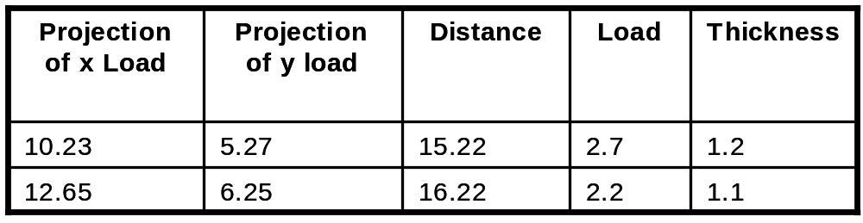
If data objects have the same fixed set of numeric attributes, then the data objects can be thought of as points in a multi-dimensional space, where each dimension represents a distinct attribute
Such data set can be represented by an m by n matrix, where there are m rows, one for each object, and n columns, one for each attribute

Slide 6

Each document becomes a `term' vector,
  each term is a component (attribute) of the vector,
  the value of each component is the number of times the corresponding term occurs in the document.

Slide 7

A special type of record data, where
  each record (transaction) involves a set of items.
  For example, consider a grocery store. The set of products purchased by a customer during one shopping trip constitute a transaction, while the individual products that were purchased are the items.

Slide 8
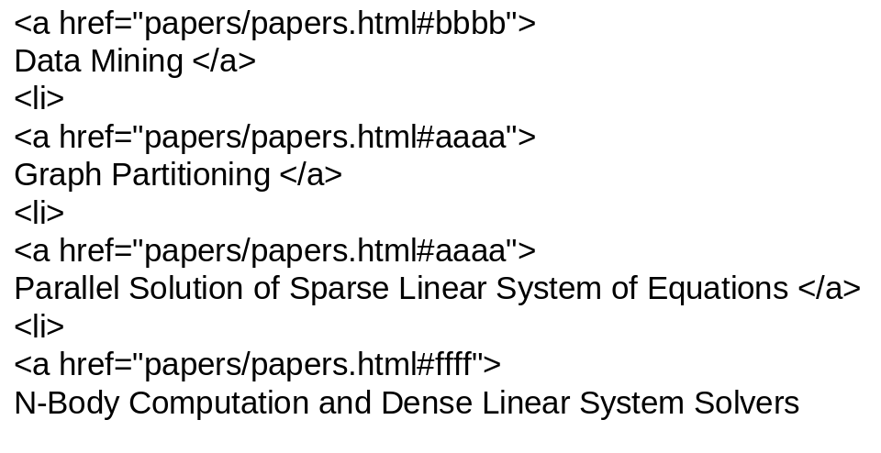
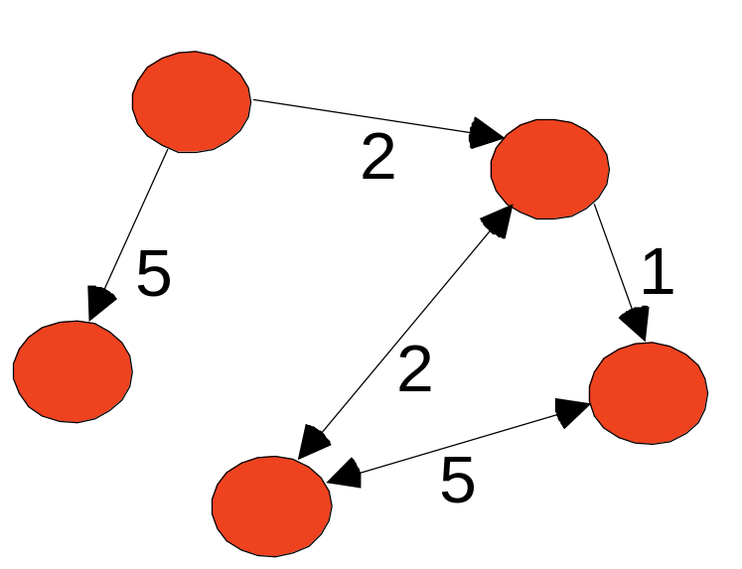
Examples: Generic graph and HTML Links

Slide 9

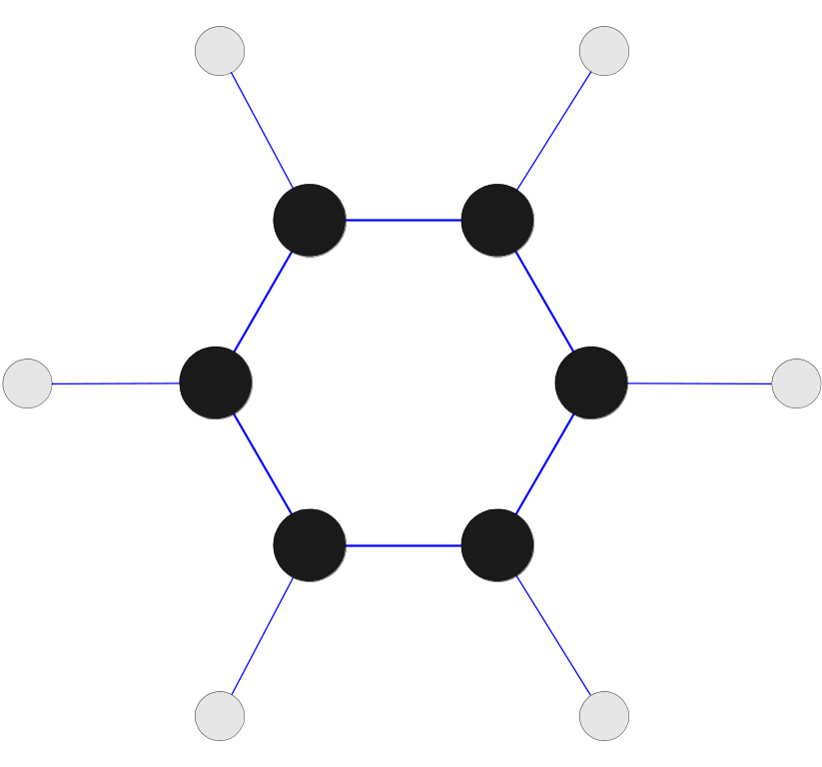
Benzene Molecule: C₆H₆

Slide 10
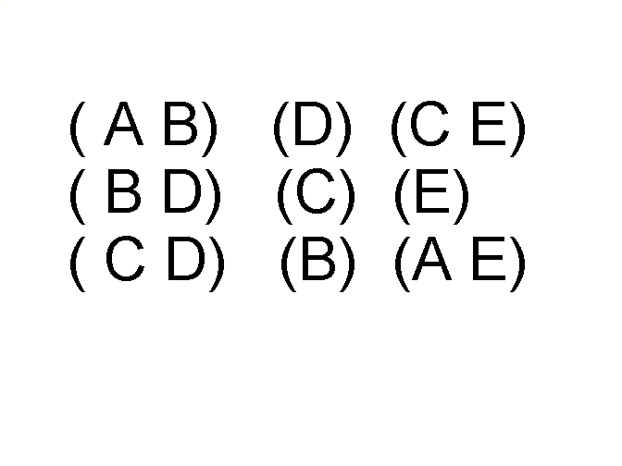
Items/Events
Sequences of transactions
An element of the sequence

Slide 11


Genomic sequence data

Slide 12
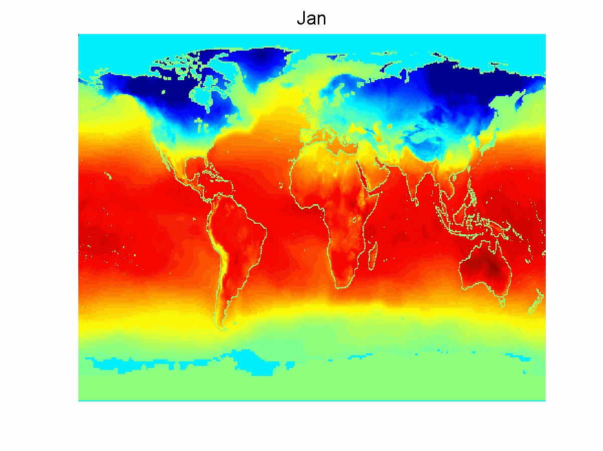
Spatio-Temporal Data
Average Monthly Temperature of land and ocean

Slide 13
Introduction, or what is knowledge?
Knowledge is a theoretical or practical understanding of a subject or a domain. Knowledge is also the sum of what is currently known, and apparently knowledge is power. Those who possess knowledge are called experts.
Anyone can be considered a domain expert if he or she has deep knowledge (of both facts and rules) and strong practical experience in a particular domain. The area of the domain may be limited. In general, an expert is a skilful person who can do things other people cannot.

Slide 14

The most diseases that infect wheat crop in Egypt are the nitrogen deficiency, leaf rust and powdery mildew. The "nitrogen deficiency" symptoms are yellowing of leaves and Thinness of the stem in addition to the death of spikes. As for "leaf rust" disease, the leaves will be wilted, stem turn red and the spikes become empty of grains. As well for the "powdery mildew" disease the white color will cover the whole plant (leaves, stem, and spike)

Slide 15

Concept | Property | Values | Source of Value | Single/multiple
Table 1

Slide 16

Concept | Property | Values | S.O.V | s/m
disorder | name | nitrogen deficiency leaf rust powdery mildew | Diagnosis model | S/M
leaf | color | Yellow, white | user | m
stem | shape | thinness | User | s
spikes | status | death | User | s
leaf | shape | wilted | User | s
stem | color | Red, white | User | s
spikes | status | empty of grains | User
spikes | color | white | user
Table 1

Slide 17

Rhs |  |  |  | Lhs
Table 2

Slide 18
Rhs |  |  |  | Lhs
Concept | Property | Operators | value | Concept | property | Table 2 value
leaf | color | = | Yellow | disorder | name | nitrogen deficiency
stem | shape | = | thinness
spikes | status | = | death
Table 2

Slide 19
The human mental process is internal, and it is too complex to be represented as an algorithm. However, most experts are capable of expressing their knowledge in the form of rules for problem solving.
IF the ‘leaf color’ is yellow
And
THEN the disorder name is nitrogen deficiency

Slide 20
Rules as a knowledge representation technique
The term rule in AI, which is the most commonly used type of knowledge representation, can be defined as an IF-THEN structure that relates given information or facts in the IF part to some action in the THEN part. A rule provides some description of how to solve a problem. Rules are relatively easy to create and understand.
Any rule consists of two parts: the IF part, called the antecedent (premise or condition) and the THEN part called the consequent (conclusion or action).

Slide 21
IF <antecedent>
THEN <consequent>
A rule can have multiple antecedents joined by the keywords AND (conjunction), OR (disjunction) or
a combination of both.
IF <antecedent 1> IF <antecedent 1>
AND <antecedent 2> OR <antecedent 2>
. .
. .
. .
AND <antecedent n> OR <antecedent n>
THEN <consequent> THEN <consequent>

Slide 22
The antecedent of a rule incorporates two parts: an object (linguistic object) and its value. The object and its value are linked by an operator.
The operator identifies the object and assigns the value. Operators such as is, are, is not, are not are used to assign a symbolic value to a linguistic object.
Expert systems can also use mathematical operators to define an object as numerical and assign it to the numerical value.
IF ‘age of the customer’ < 18
AND ‘cash withdrawal’ > 1000
THEN ‘signature of the parent’ is required

Slide 23
Rules can represent relations, recommendations, directives, strategies and heuristics:
Relation
IF the ‘fuel tank’ is empty
THEN the car is dead
Recommendation
IF the season is autumn
AND the sky is cloudy
AND the forecast is drizzle
THEN the advice is ‘take an umbrella’
Directive
IF the car is dead
AND the ‘fuel tank’ is empty
THEN the action is ‘refuel the car’

Slide 24
Strategy
IF the car is dead
THEN the action is ‘check the fuel tank’;
step1 is complete
IF step1 is complete
AND the ‘fuel tank’ is full
THEN the action is ‘check the battery’;
step2 is complete
Heuristic
IF the spill is liquid
AND the ‘spill pH’ < 6
AND the ‘spill smell’ is vinegar
THEN the ‘spill material’ is ‘acetic acid’

Slide 25
The main players in the development team
There are five members of the expert system development team: the domain expert, the knowledge engineer, the programmer, the project manager and the end-user.
The success of their expert system entirely depends on how well the members work together.

Slide 26
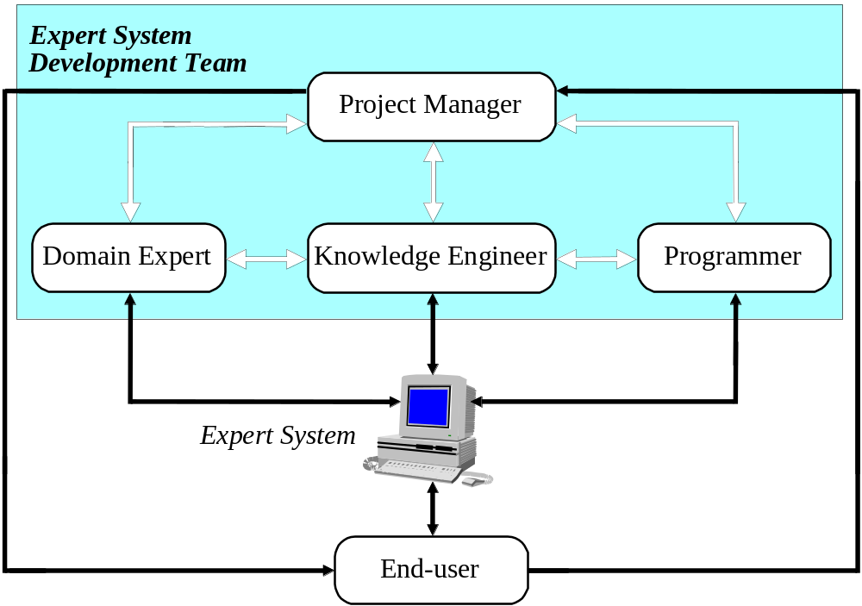
The main players in the development team

Slide 27
The domain expert is a knowledgeable and skilled person capable of solving problems in a specific area or domain. This person has the greatest expertise in a given domain. This expertise is to be captured in the expert system. Therefore, the expert must be able to communicate his or her knowledge, be willing to participate in the expert system development and commit a substantial amount of time to the project. The domain expert is the most important player in the expert system development team.

Slide 28
The knowledge engineer is someone who is capable of designing, building and testing an expert system. He or she interviews the domain expert to find out how a particular problem is solved. The knowledge engineer establishes what reasoning methods the expert uses to handle facts and rules and decides how to represent them in the expert system. The knowledge engineer then chooses some development software or an expert system shell, or looks at programming languages for encoding the knowledge. And finally, the knowledge engineer is responsible for testing, revising and integrating the expert system into the workplace.

Slide 29
The programmer is the person responsible for the actual programming, describing the domain knowledge in terms that a computer can understand. The programmer needs to have skills in symbolic programming in such AI languages as LISP, Prolog and OPS5 and also some experience in the application of different types of expert system shells. In addition, the programmer should know conventional programming languages like C, Pascal, FORTRAN and Basic.

Slide 30
The project manager is the leader of the expert system development team, responsible for keeping the project on track. He or she makes sure that all deliverables and milestones are met, interacts with the expert, knowledge engineer, programmer and end-user.
The end-user, often called just the user, is a person who uses the expert system when it is developed. The user must not only be confident in the expert system performance but also feel comfortable using it. Therefore, the design of the user interface of the expert system is also vital for the project’s success; the end-user’s contribution here can be crucial.

Slide 31
Structure of a rule-based expert system
In the early seventies, Newell and Simon from Carnegie-Mellon University proposed a production system model, the foundation of the modern rule-based expert systems.
The production model is based on the idea that humans solve problems by applying their knowledge (expressed as production rules) to a given problem represented by problem-specific information.
The production rules are stored in the long-term memory and the problem-specific information or facts in the short-term memory.

Slide 32
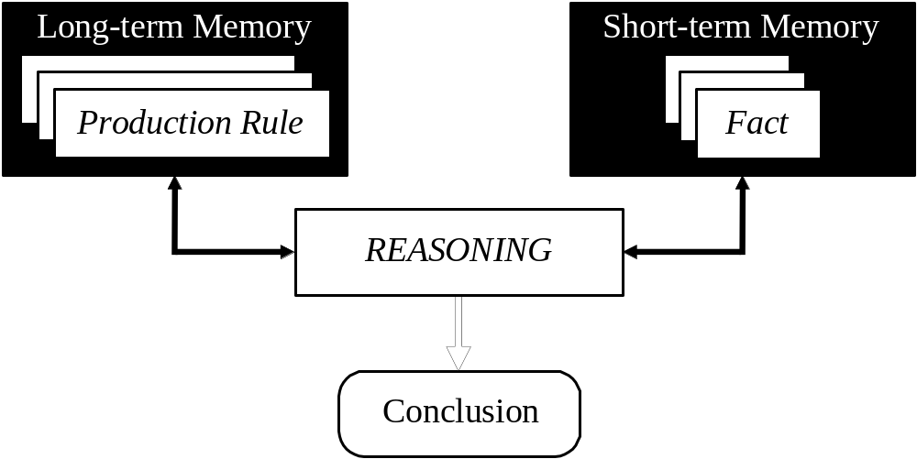
Production system model

Slide 33
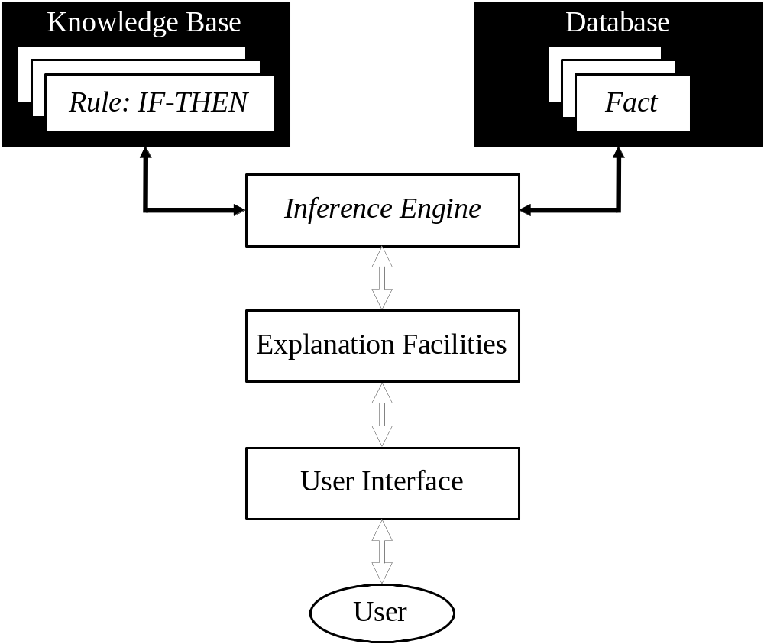
Basic structure of a rule-based expert system

Slide 34
The knowledge base contains the domain knowledge useful for problem solving. In a rule-based expert system, the knowledge is represented as a set of rules. Each rule specifies a relation, recommendation, directive, strategy or heuristic and has the IF (condition) THEN (action) structure. When the condition part of a rule is satisfied, the rule is said to fire and the action part is executed.
The database includes a set of facts used to match against the IF (condition) parts of rules stored in the knowledge base.

Slide 35
The inference engine carries out the reasoning whereby the expert system reaches a solution. It links the rules given in the knowledge base with the facts provided in the database.
The explanation facilities enable the user to ask the expert system how a particular conclusion is reached and why a specific fact is needed. An expert system must be able to explain its reasoning and justify its advice, analysis or conclusion.
The user interface is the means of communication between a user seeking a solution to the problem and an expert system.

Slide 36
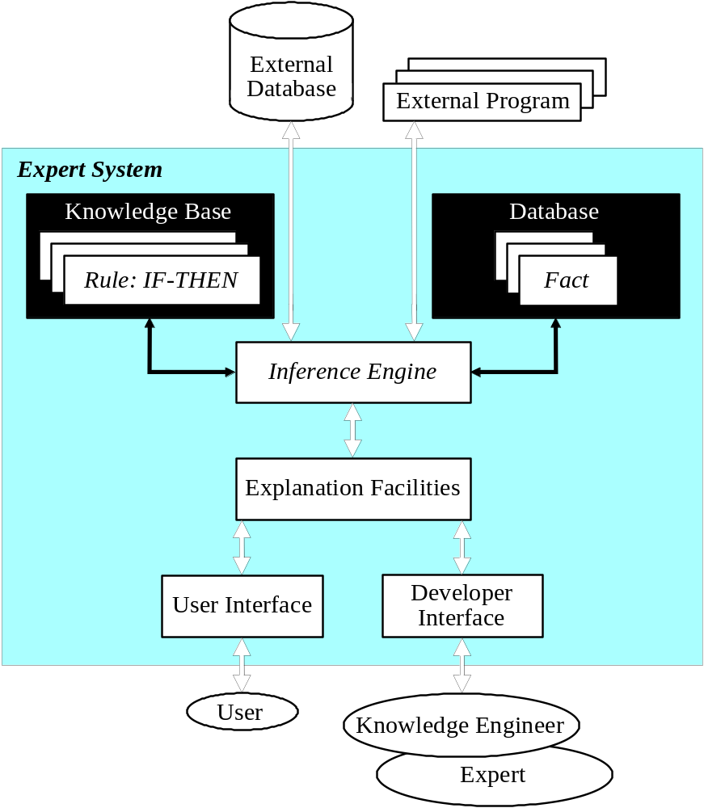
Complete structure of a rule-based expert system

Slide 37
Characteristics of an expert system
An expert system is built to perform at a human expert level in a narrow, specialised domain. Thus, the most important characteristic of an expert system is its high-quality performance. No matter how fast the system can solve a problem, the user will not be satisfied if the result is wrong.
On the other hand, the speed of reaching a solution is very important. Even the most accurate decision or diagnosis may not be useful if it is too late to apply, for instance, in an emergency, when a patient dies or a nuclear power plant explodes.

Slide 38
Expert systems apply heuristics to guide the reasoning and thus reduce the search area for a solution.
A unique feature of an expert system is its explanation capability. It enables the expert system to review its own reasoning and explain its decisions.
Expert systems employ symbolic reasoning when solving a problem. Symbols are used to represent different types of knowledge such as facts, concepts and rules.

Slide 39
Can expert systems make mistakes?
Even a brilliant expert is only a human and thus can make mistakes. This suggests that an expert system built to perform at a human expert level also should be allowed to make mistakes. But we still trust experts, even we recognise that their judgements are sometimes wrong. Likewise, at least in most cases, we can rely on solutions provided by expert systems, but mistakes are possible and we should be aware of this.

Slide 40
In expert systems, knowledge is separated from its processing (the knowledge base and the inference engine are split up). A conventional program is a mixture of knowledge and the control structure to process this knowledge. This mixing leads to difficulties in understanding and reviewing the program code, as any change to the code affects both the knowledge and its processing.
When an expert system shell is used, a knowledge engineer or an expert simply enters rules in the knowledge base. Each new rule adds some new knowledge and makes the expert system smarter.

Slide 41
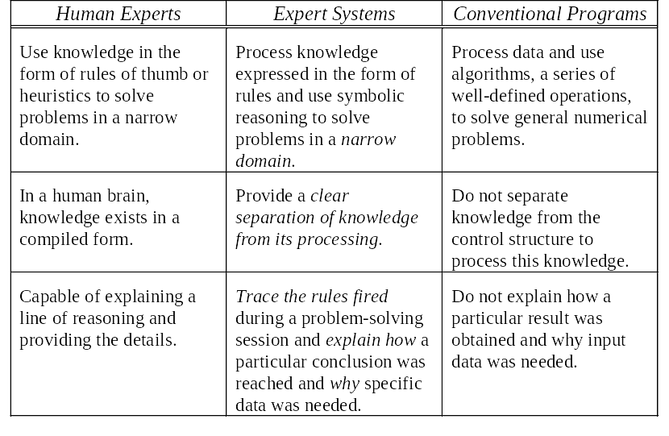
Comparison of expert systems with conventional systems and human experts

Slide 42
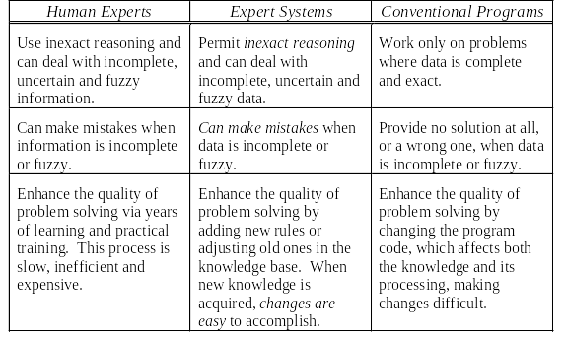
Comparison of expert systems with conventional systems and human experts (Continued)

Slide 43
Forward chaining and backward chaining
In a rule-based expert system, the domain knowledge is represented by a set of IF-THEN production rules and data is represented by a set of facts about the current situation. The inference engine compares each rule stored in the knowledge base with facts contained in the database. When the IF (condition) part of the rule matches a fact, the rule is fired and its THEN (action) part is executed.
The matching of the rule IF parts to the facts produces inference chains. The inference chain indicates how an expert system applies the rules to reach a conclusion.

Slide 44
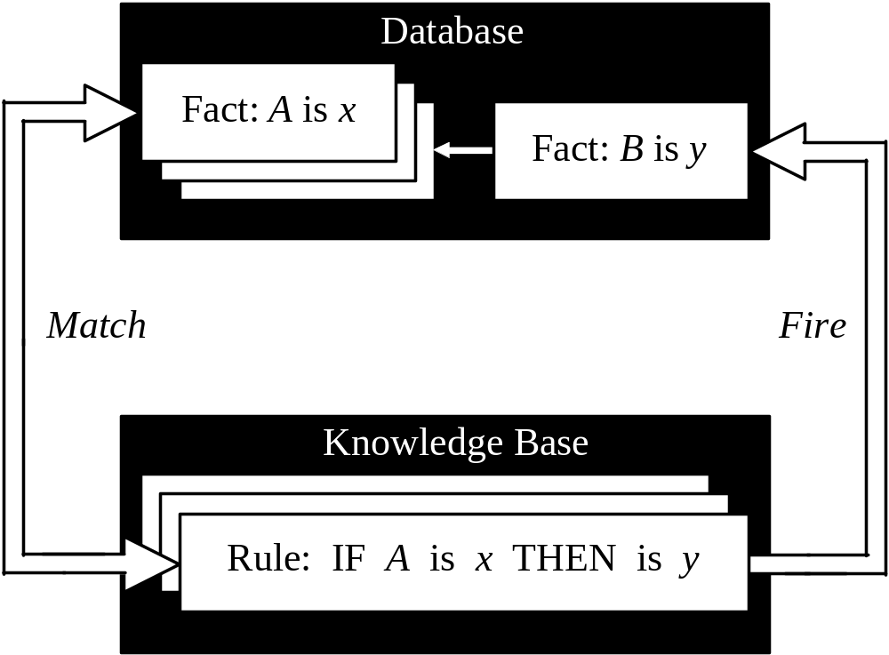
Inference engine cycles via a match-fire procedure

Slide 45
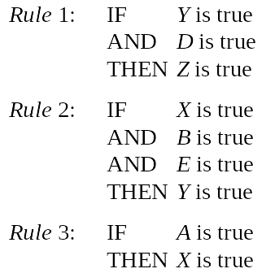
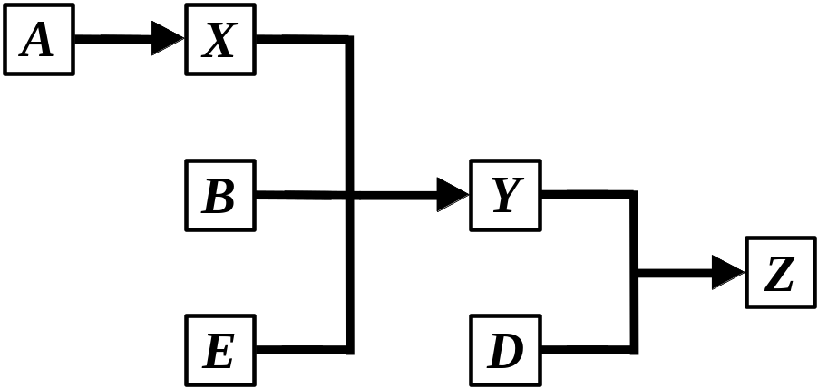
An example of an inference chain

Slide 46
Forward chaining
Forward chaining is the data-driven reasoning. The reasoning starts from the known data and proceeds forward with that data. Each time only the topmost rule is executed. When fired, the rule adds a new fact in the database. Any rule can be executed only once. The match-fire cycle stops when no further rules can be fired.

Slide 47
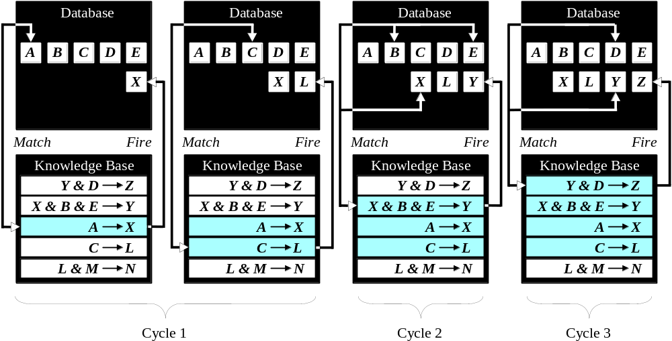
Forward chaining

Slide 48
Forward chaining is a technique for gathering information and then inferring from it whatever can be inferred.
However, in forward chaining, many rules may be executed that have nothing to do with the established goal.
Therefore, if our goal is to infer only one particular fact, the forward chaining inference technique would not be efficient.

Slide 49
Backward chaining
Backward chaining is the goal-driven reasoning. In backward chaining, an expert system has the goal (a hypothetical solution) and the inference engine attempts to find the evidence to prove it. First, the knowledge base is searched to find rules that might have the desired solution. Such rules must have the goal in their THEN (action) parts. If such a rule is found and its IF (condition) part matches data in the database, then the rule is fired and the goal is proved. However, this is rarely the case.

Slide 50
Backward chaining
Thus the inference engine puts aside the rule it is working with (the rule is said to stack) and sets up a new goal, a subgoal, to prove the IF part of this rule. Then the knowledge base is searched again for rules that can prove the subgoal. The inference engine repeats the process of stacking the rules until no rules are found in the knowledge base to prove the current subgoal.

Slide 51
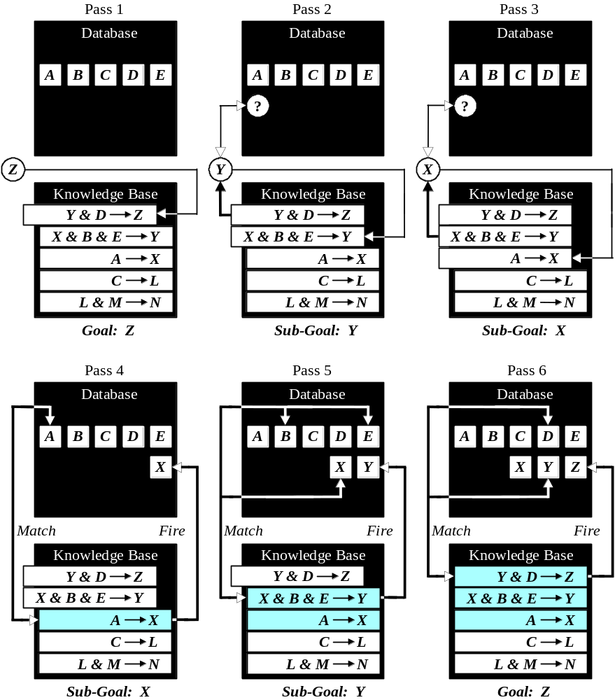
Backward chaining

Slide 52
How do we choose between forward and backward chaining?
If an expert first needs to gather some information and then tries to infer from it whatever can be inferred, choose the forward chaining inference engine.
However, if your expert begins with a hypothetical solution and then attempts to find facts to prove it, choose the backward chaining inference engine.

Slide 53
Conflict resolution
Earlier we considered two simple rules for crossing a road. Let us now add third rule:
Rule 1:
IF the ‘traffic light’ is green
THEN the action is go
Rule 2:
IF the ‘traffic light’ is red
THEN the action is stop
Rule 3:
IF the ‘traffic light’ is red
THEN the action is go

Slide 54
We have two rules, Rule 2 and Rule 3, with the same IF part. Thus both of them can be set to fire when the condition part is satisfied. These rules represent a conflict set. The inference engine must determine which rule to fire from such a set. A method for choosing a rule to fire when more than one rule can be fired in a given cycle is called conflict resolution.

Slide 55
In forward chaining, BOTH rules would be fired. Rule 2 is fired first as the topmost one, and as a result, its THEN part is executed and linguistic object action obtains value stop. However, Rule 3 is also fired because the condition part of this rule matches the fact ‘traffic light’ is red, which is still in the database. As a consequence, object action takes new value go.

Slide 56
Methods used for conflict resolution
Fire the rule with the highest priority. In simple applications, the priority can be established by placing the rules in an appropriate order in the knowledge base. Usually this strategy works well for expert systems with around 100 rules.
Fire the most specific rule. This method is also known as the longest matching strategy. It is based on the assumption that a specific rule processes more information than a general one.

Slide 57
Fire the rule that uses the data most recently entered in the database. This method relies on time tags attached to each fact in the database. In the conflict set, the expert system first fires the rule whose antecedent uses the data most recently added to the database.

Slide 58
Metaknowledge
Metaknowledge can be simply defined as knowledge about knowledge. Metaknowledge is knowledge about the use and control of domain knowledge in an expert system.
In rule-based expert systems, metaknowledge is represented by metarules. A metarule determines a strategy for the use of task-specific rules in the expert system.

Slide 59
Metarules
Metarule 1:
Rules supplied by experts have higher priorities than rules supplied by novices.
Metarule 2:
Rules governing the rescue of human lives have higher priorities than rules concerned with clearing overloads on power system equipment.

Slide 60
Advantages of rule-based expert systems
Natural knowledge representation. An expert usually explains the problem-solving procedure with such expressions as this: “In such-and-such situation, I do so-and-so”. These expressions can be represented quite naturally as IF-THEN production rules.
Uniform structure. Production rules have the uniform IF-THEN structure. Each rule is an independent piece of knowledge. The very syntax of production rules enables them to be self-documented.

Slide 61
Advantages of rule-based expert systems
Separation of knowledge from its processing. The structure of a rule-based expert system provides an effective separation of the knowledge base from the inference engine. This makes it possible to develop different applications using the same expert system shell.
Dealing with incomplete and uncertain knowledge. Most rule-based expert systems are capable of representing and reasoning with incomplete and uncertain knowledge.

Slide 62
Disadvantages of rule-based expert systems
Opaque relations between rules. Although the individual production rules are relatively simple and self-documented, their logical interactions within the large set of rules may be opaque. Rule-based systems make it difficult to observe how individual rules serve the overall strategy.
Ineffective search strategy. The inference engine applies an exhaustive search through all the production rules during each cycle. Expert systems with a large set of rules (over 100 rules) can be slow, and thus large rule-based systems can be unsuitable for real-time applications.

Slide 63
Disadvantages of rule-based expert systems
Inability to learn. In general, rule-based expert systems do not have an ability to learn from the experience. Unlike a human expert, who knows when to “break the rules”, an expert system cannot automatically modify its knowledge base, or adjust existing rules or add new ones. The knowledge engineer is still responsible for revising and maintaining the system.

